Slide 1
In pairs, discuss what hobbies you take part in.
What is your hobby?
How often do you practice it?
Is your hobby expensive or cheap?
What do you think is the most popular hobbies in your country?

Slide 2
Weird Hobbies

Slide 3
You are now going to look at some photos of peoples’ unusual hobbies.
In pairs, look at the photos and first guess what the hobby is and then which hobby you would like to try.

Slide 4
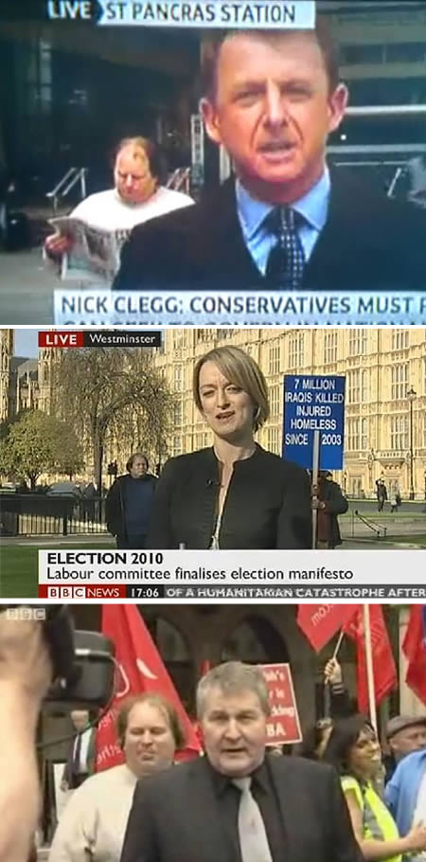
Appearing in the background on TV.

Slide 5
Paul Yarrow of south London definitely has a hobby: he likes to appear on television. So whenever a news camera crew gets set up in a public venue, he hangs around in the background on camera. He has appeared in the background of live news reports on BBC, ITV, Channel 4 and Sky News at random locations and at random times.
Source

Slide 6
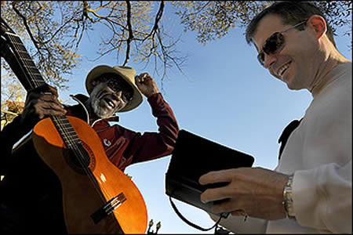
Giving away ten dollars to strangers

Slide 7
Reed Sandridge lost his job last year and took up a new hobby. He gives away $10 every day to someone who looks as if they could use it, a different person every day.
Source

Slide 8
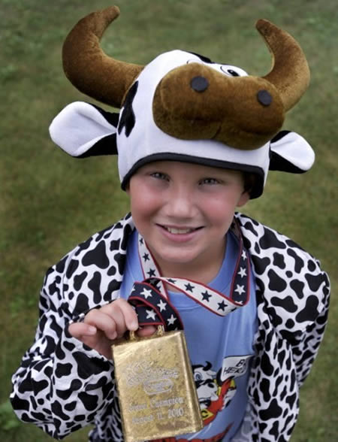
Mooing

Slide 9
When it comes to mooing, 10-year-old Austin Siok is an expert. The Dyer Intermediate School fifth-grader won an annual mooing contest at the Wisconsin State Fair because he sounded more like a real cow than the other about 80 contest participants. Austin has mooed a lot since kindergarten and said he started doing it even more this summer after his family read about a mooing contest at the Racine County Fair and decided to enter Austin.
Source

Slide 10
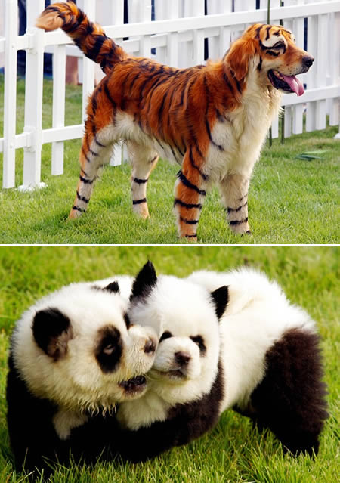
Making dogs look like different animals.

Slide 11
That's not a tiger in the picture, but a dog dyed to look like a tiger. It's an example of a growing hobby in China: dying and trimming dogs' hair so that they look like different animals.
Source

Slide 12
Made by
2014

